Slide 1
Predictive Modeling Using Generalized Linear Models College of Science, Engineering and Technology, Grand Canyon University DSC-530: Predictive Modeling
Jonathan Ibifubara Pollyn

Slide 2
Introduction
Advertisements are used to attract the attention of potential customers
Companies should budget for advertisement to run over time since a single campaign's impacts are temporary
Frequent advertising can raise awareness to the point where a product's nature and benefits are fully understood
Advertising on the Internet makes it easier to quantify the effects of advertising on product awareness and use
When customers click on your Internet ad to find out more about your product, you can see right away if the campaign was a success based on how many people responded

Slide 3
Background
Logistic model, you can forecast the response variable's outcome
Advertising dataset is used to model a logistic regression model for the purpose of understanding
How age influences a customer to click on Ad
How Area Income influences a customer to click on Ad
Predictor variables are:
Age
Area Income
Response Variable:
Clicked on Ad

Slide 4
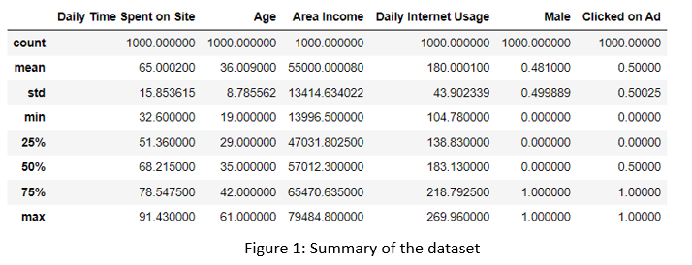
Dataset Summary
When customer spends more time on the site, the better the chance of clicking on the Ad
Figure 1: shows that 75 percent of the time a customer spent on the site, there is a chance that they will click on the Ad
zero chance of them clicking on the Ad if they spent just 25 percent.

Slide 5
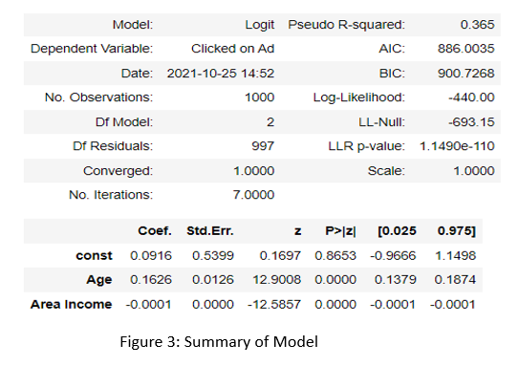

Model Summary
Predictors (Age and Area Income) are statistically significant
Figure 3: shows that the p-values for both Age and Area Income are < 0.05
Descriptive form of the final regression model is:
yhat(Clicked on Ad) =$\frac{exp⁡(exp(−0.00916+0.1626(age)−0.0001(Area Income))}{1+exp(−0.0916+0.1626(age)−0.0001(Area Income))}$
Age coefficient reveals that a customer is increasingly likely to click on an Ad with an age of approximately 117% or 1.17
the probability of having a higher click on Ads every five years after the customer has clicked it before is likely to increase by 235% or 2.35

Slide 6
Model Summary Cont.
Coefficient of the Area Income demonstrates that a customer clicking on an Ad is expected to increase approximately 99.9% or 0.99
If a customer Area Income increased by 5,000, then the clicked-on Ads is likely to increase approximately 60.7% or 0.61

Slide 7
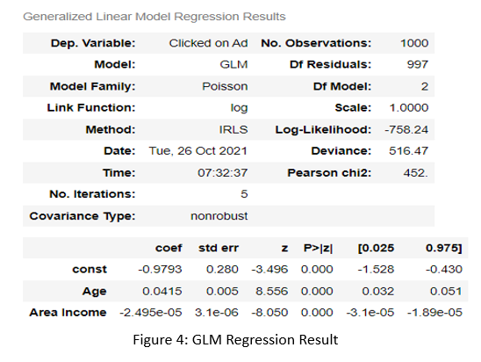

Poisson regression
All variables belong to the model, and we do not have to remove anyone.
Descriptive form of the Poisson regression is derived from figure 4 as
$${yhat=e}^{(−0.9793+0.0415\left(age\right)−2.495e−05(Area Income)}$$

Slide 8
Used Code
The code and other visuals are in a PDF file called DSC-530 Week 8 - Final Predictive Modeling Project
A written report called Week 8 Assignment Report is also included.

Slide 9
Conclusion
Advertisement helps generate revenue for companies as customers are likely to purchase a product when they click on an Ad
The advertising dataset that was modeled shows that the more time a customer spends on the site, the more likely they will click on the Ad
The model shows that younger customers are more likely to click on Ads when compared to more older customers

Slide 10
Reference
Larose, C. D., Larose, D. T., & Larose, Chantal D., Author. (2019). Data science using python and r. John Wiley & Sons,inc,.
Linton, I. (n.d.). How does advertising affect product awareness & use? Small Business – Chron.com. https://smallbusiness.chron.com/advertising-affect-product-awareness-use-36750.html

